Slide 1

House Price Prediction
Shivansh jha

Slide 2
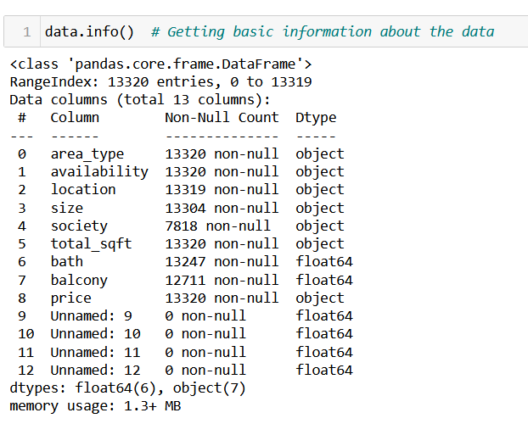
Problem Statement
Given: Data of a Real Estate company.
Task: To find Property Price evaluations as per the location and to develop a predictive machine learning model.

Slide 3
Data Cleaning for EDA
The following steps were taken for cleaning data before EDA:
Removing the unnamed columns.
Treating the missing values.
Handling the unexpected datatypes.
Handling the dates present in availability column.
Handling the currency symbols in price column.
Dropping duplicate rows.

Slide 4

Exploratory Data Analysis

Slide 5
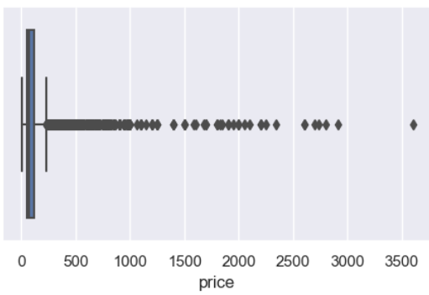
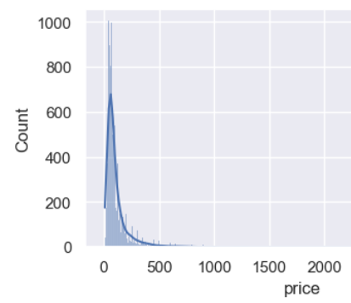
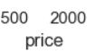
Univariate Analysis
Price column
This is our target variable & will be considered as Y.
There were outliers in this column which should be imputed.
The column 'price' is highly right skewed. Thus, the frequency of houses with low price is more.

Slide 6
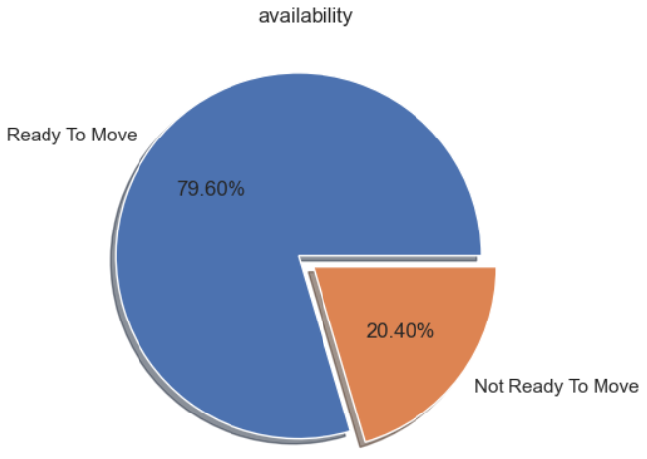
Univariate Analysis
Availability column
Almost 80% of the people are ready to move in the property which may be due to the current price being less or some urgency to move.
Date of availability of remaining people is stored in other columns.

Slide 7
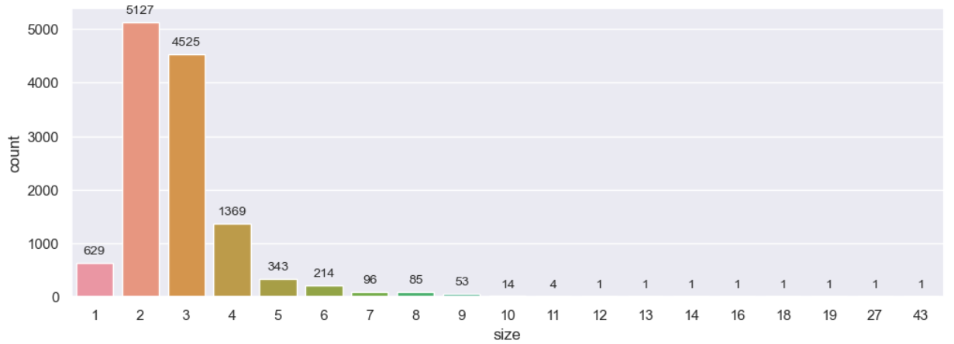
Univariate Analysis
Size column
The most common size of property is having 1 to 4 bedrooms and it is extremely rare to find ones with 10 bedrooms or more.
This may be due to less demand of such huge properties.

Slide 8
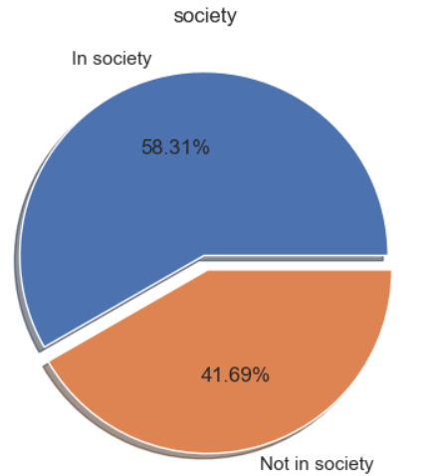
Univariate Analysis
Society column
This shows that more properties are present in societies compared to those not in society.
This may be because of the demand from people to live in a society.

Slide 9
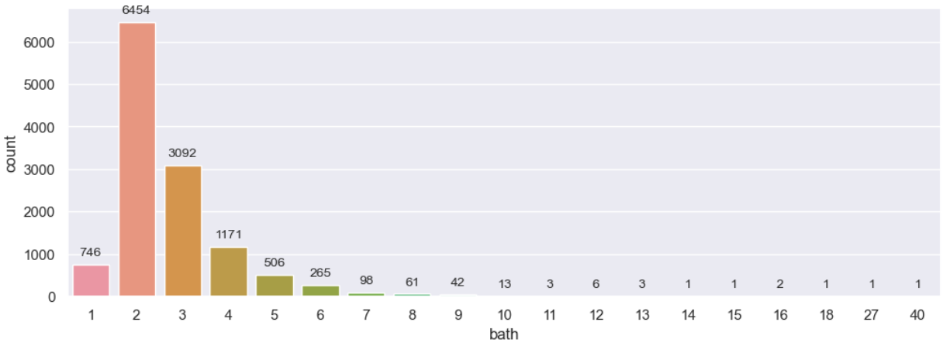
Univariate Analysis
Bath column
This distribution is somewhat similar to that of size column, which is logical because no. of bathrooms often depends on the no. of bedrooms.
The most common no. of bathrooms is 1 to 4 and that it's extremely rare to find ones with 10 bathrooms or more.

Slide 10
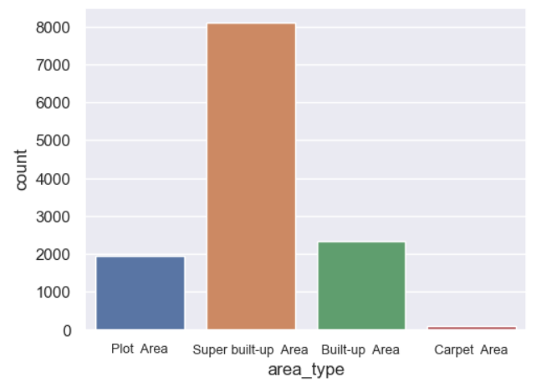
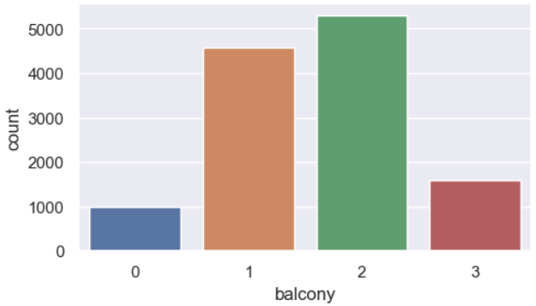
Univariate Analysis
Area_type Column
Balcony Column
The most common area type is Super built-up area.
It is most common to have 1-2 balconies. Having 3 or no balconies is also a possibility but not more than 3.

Slide 11
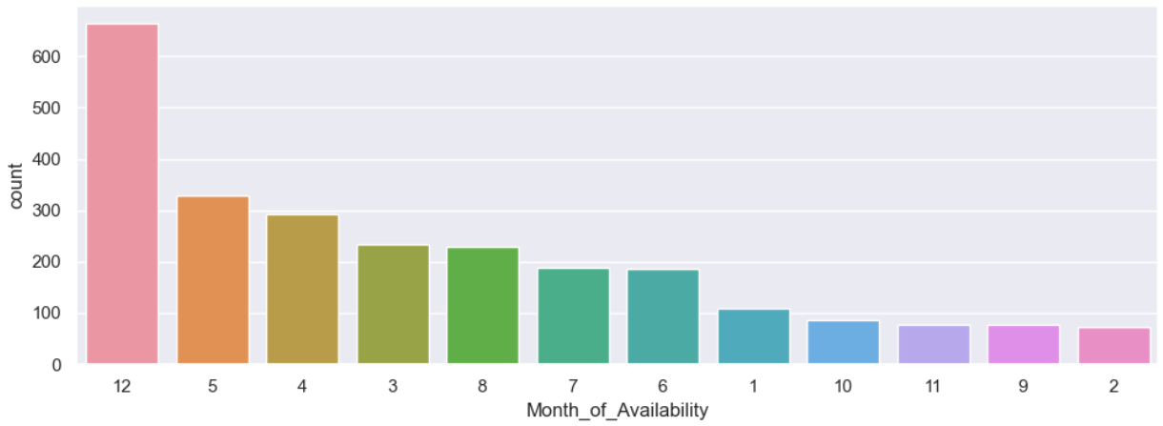
Univariate Analysis
Month_of_Availability column
It can be observed that most people who aren't ready to move, become available in December(12) or from March to May(3 - 5).
This may be due to summer vacations / end of exams for children from March to May or due to Christmas holidays in December, giving people time to relocate.

Slide 12
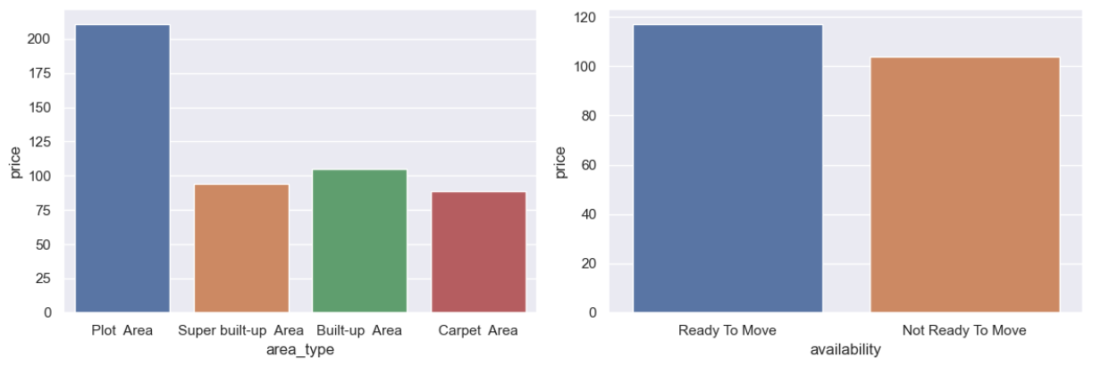
Bivariate Analysis
Area_type vs Price: Plot area is the most expensive area type. Super built-up area being less expensive can be a reason for it being common.
Availability vs Price: Those who are ready to move have to pay a greater amount compared to those who aren't available. This may be because people of 'Ready to Move' category might have urgent need of moving and those from the other category might wait for reduced price.

Slide 13
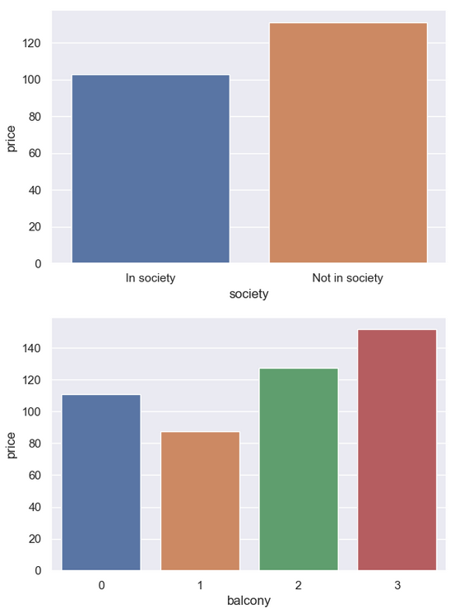
Bivariate Analysis
Society and Price columns
Properties in society are less expensive than those not in societies. This may be due to people owning expensive bungalows outside societies.
Balcony and Price columns
An increasing trend is expected, and it is increasing with properties with 3 balconies being the most expensive. However, those with 1 balcony are cheaper compared to those with none.

Slide 14
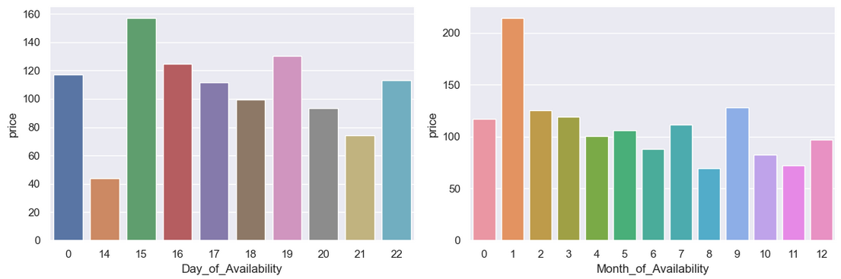
Bivariate Analysis
Day_of_Availability and Price columns
15th day of the month is the most expensive for moving into properties.
Month_of_Availability and Price columns
January is an unusually costly month for moving into properties and August is the cheapest.

Slide 15
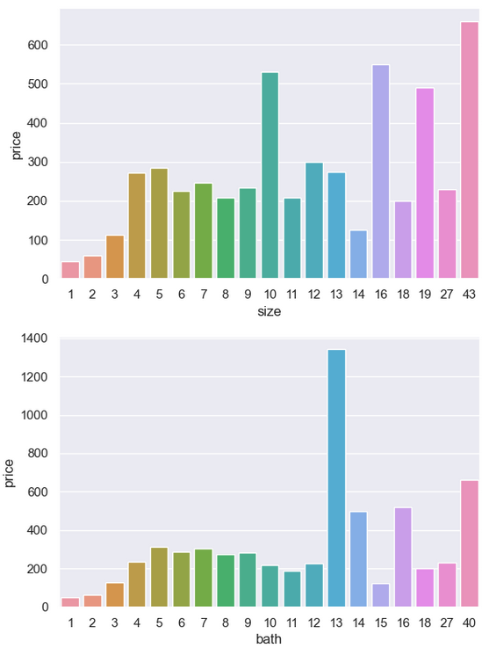
Bivariate Analysis
Size and Price columns
A regular increasing trend is expected with price increasing with bedrooms, but this is a bit irregular.
It may be due to dynamic pricing and price depending on other factors as well.
Bath and Price columns
Like size, a regular increasing trend is expected here, but it is a bit irregular. Properties with 13 bathrooms are found to be most expensive.

Slide 16
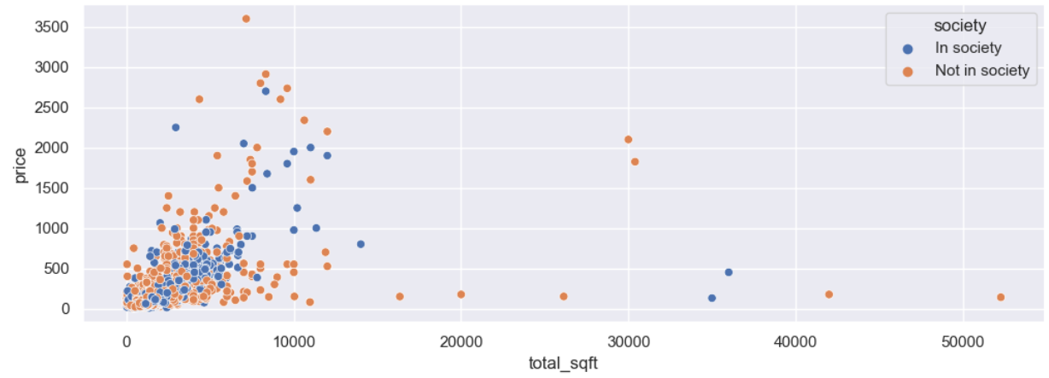
Multivariate Analysis
Total_sqft, Price and Society columns
For properties in society, price seems to be having a generally positive correlation with total_sqft. However, this is not the case with those not in society.
People may have bought huge lands with high areas in sq ft outside societies at a cheap price which isn't possible in societies.

Slide 17
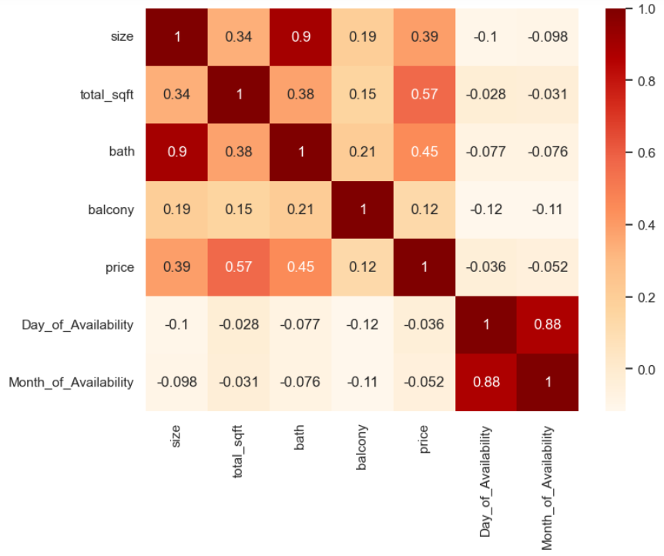
Multivariate Analysis
Correlation Matrix
We can see that 2 pairs of columns have a very strong correlation between them.
Size and Bath columns
Day_of_Availability and Month_of_Availability columns
One column from each pair should be removed.

Slide 18

Data Modelling

Slide 19
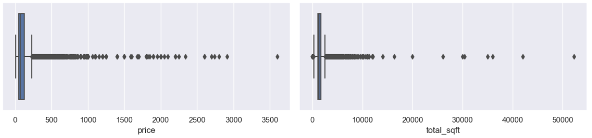
Outlier Detection
Both price and total_sqft have outliers and these must be treated.

Slide 20

Data Preprocessing for Modelling
The following steps were taken for preprocessing data before Modelling:
Reducing categories for Categorical Columns
Skewness Treatment
Encoding the Data
Scaling the Data

Slide 21
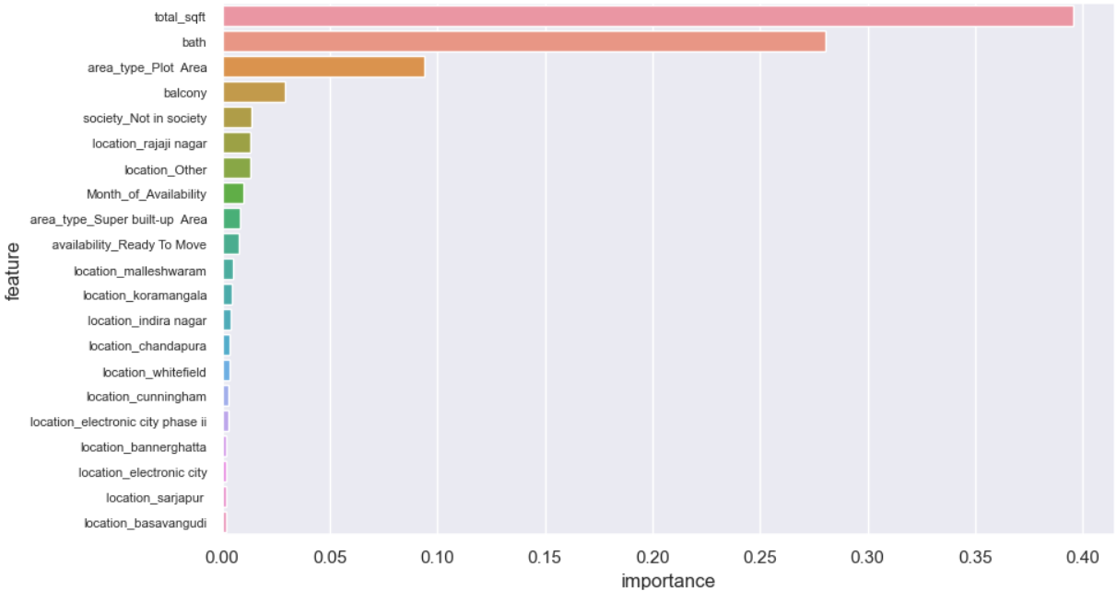
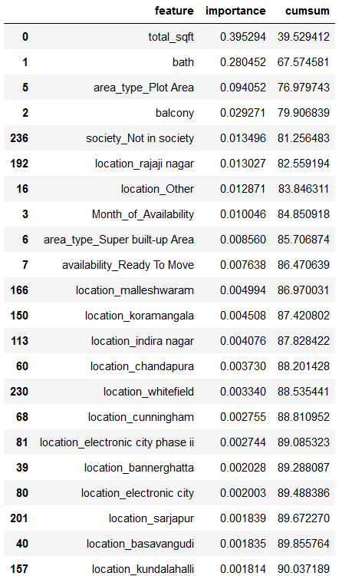
Feature Importance
This graph is plotted using sklearn.ensemble.ExtraTreesRegressor.

Slide 22
Model Comparison
Model | Training score | R2 Score | Adjusted R2 score
XGBRegressor | 85.97% | 78.2% | 77.6%
Random Forest Regressor | 83.9% | 75.9% | 75.3%
Decision Tree Regressor | 75.3% | 72.7% | 71.9%
Linear Regression | 70.2% | 72.4% | 71.6%
K-Neighbors Regressor | 79.9% | 70.8% | 70.0%

Slide 23

THANK YOU

